Slide 1

Machine Learning Project

Slide 2
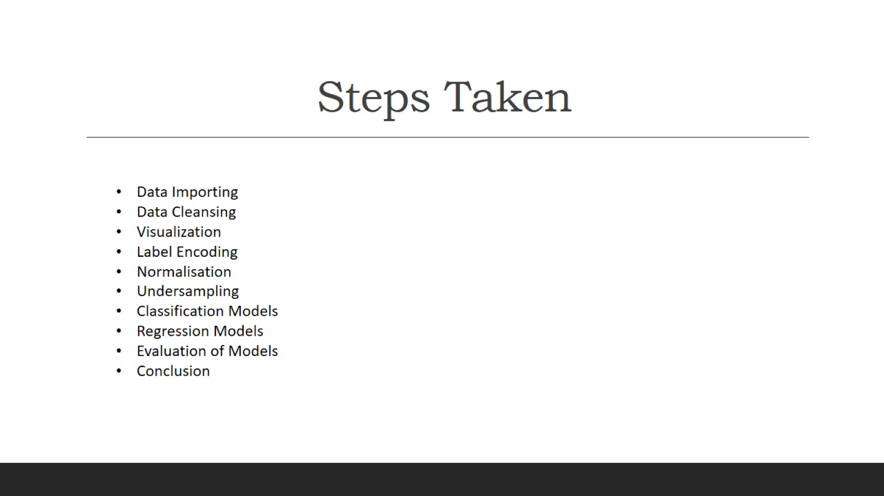
Steps Taken

Slide 3
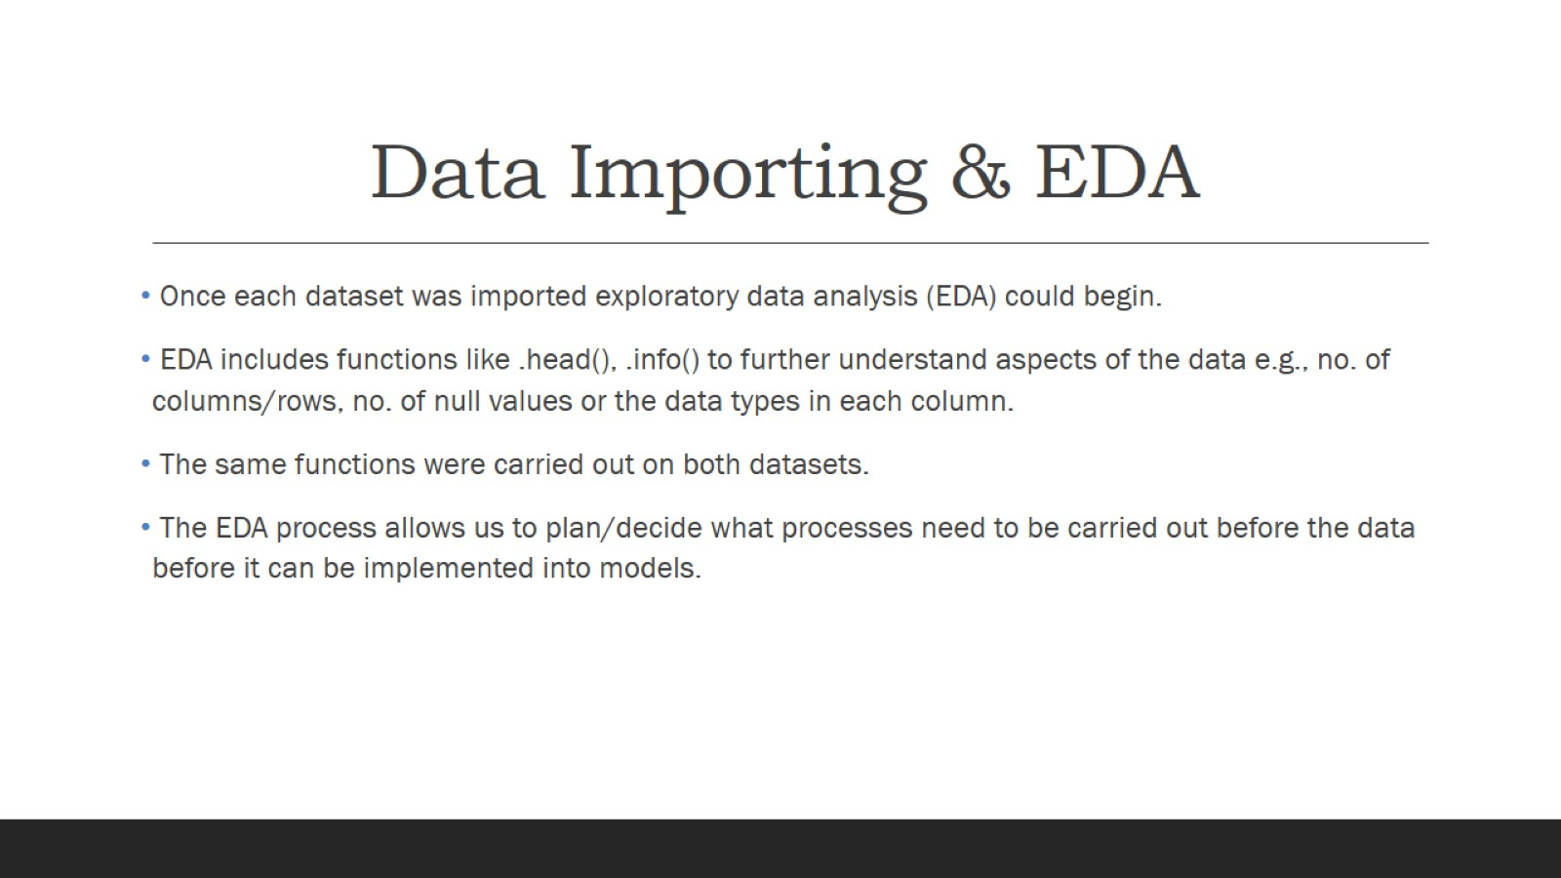
Data Importing & EDA

Slide 4
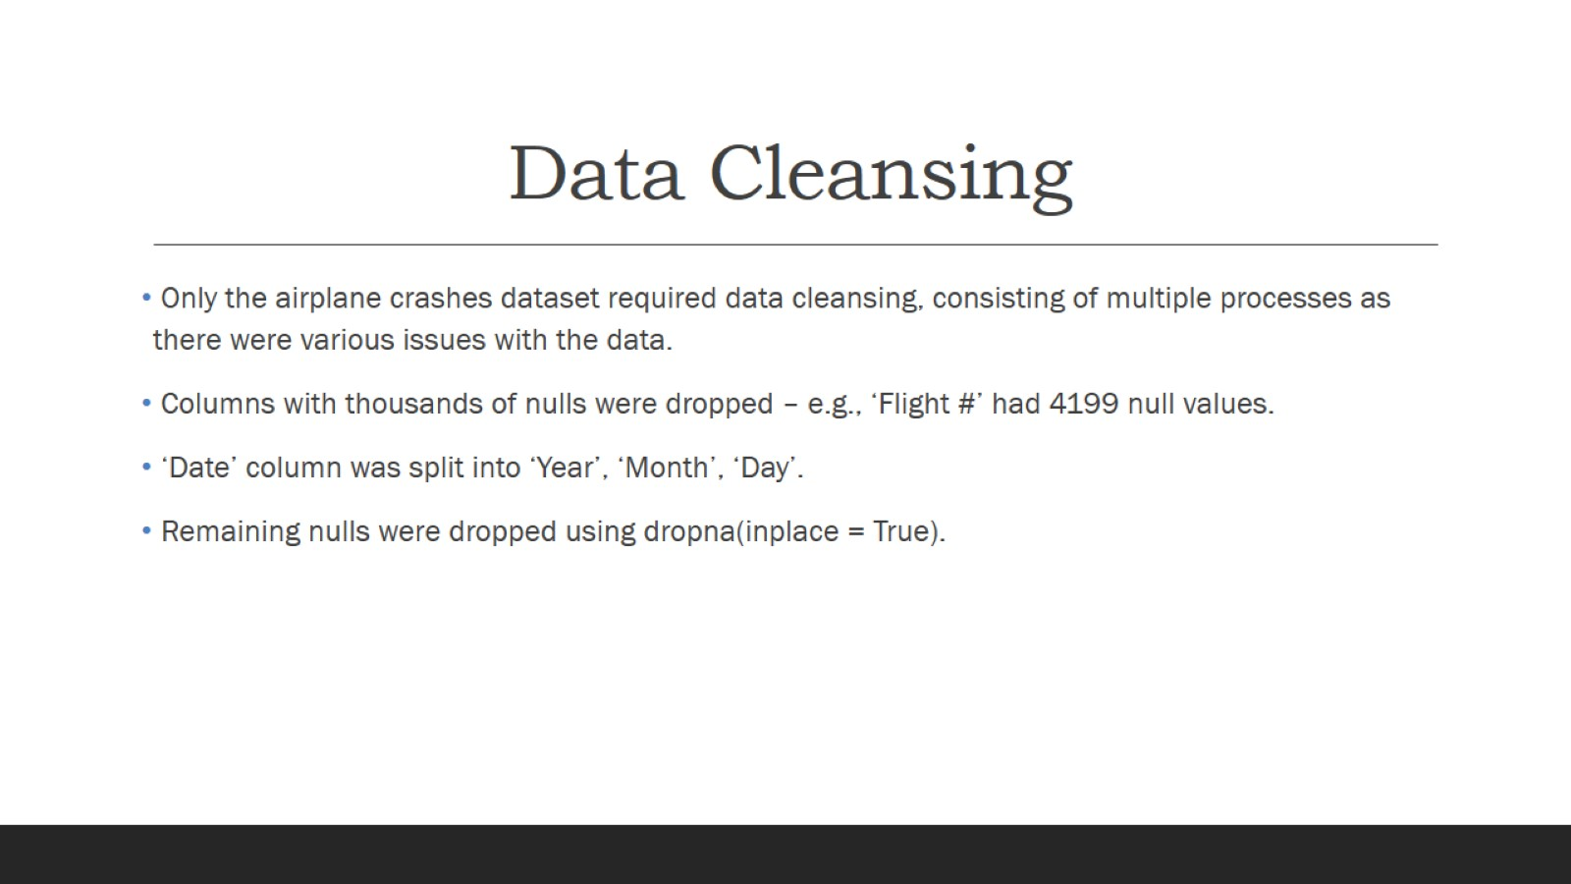
Data Cleansing

Slide 5
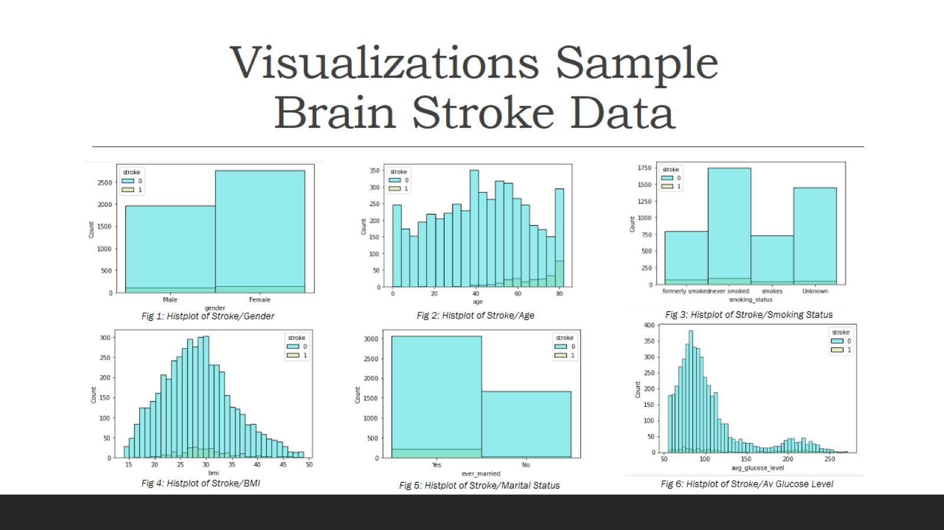
Visualizations Sample Brain Stroke Data

Slide 6
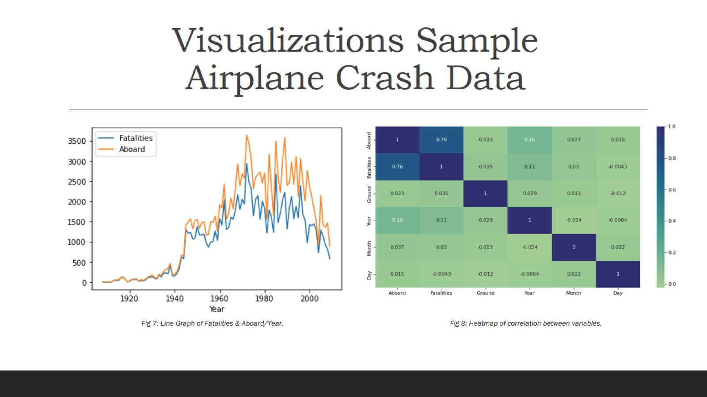
Visualizations Sample Airplane Crash Data

Slide 7
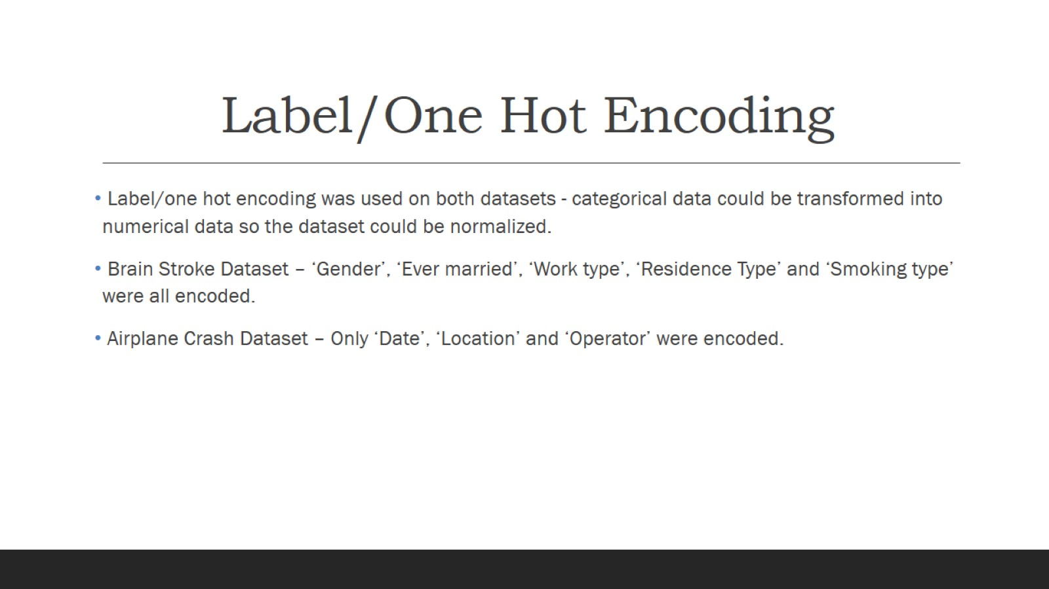
Label/One Hot Encoding

Slide 8
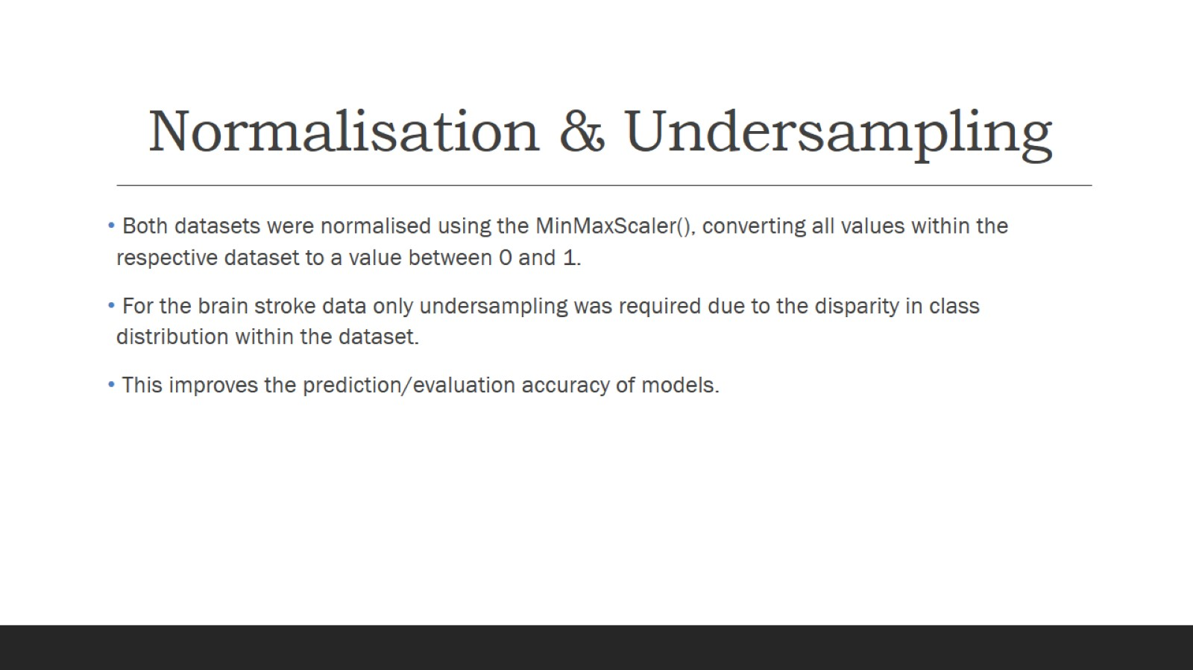
Normalisation & Undersampling

Slide 9
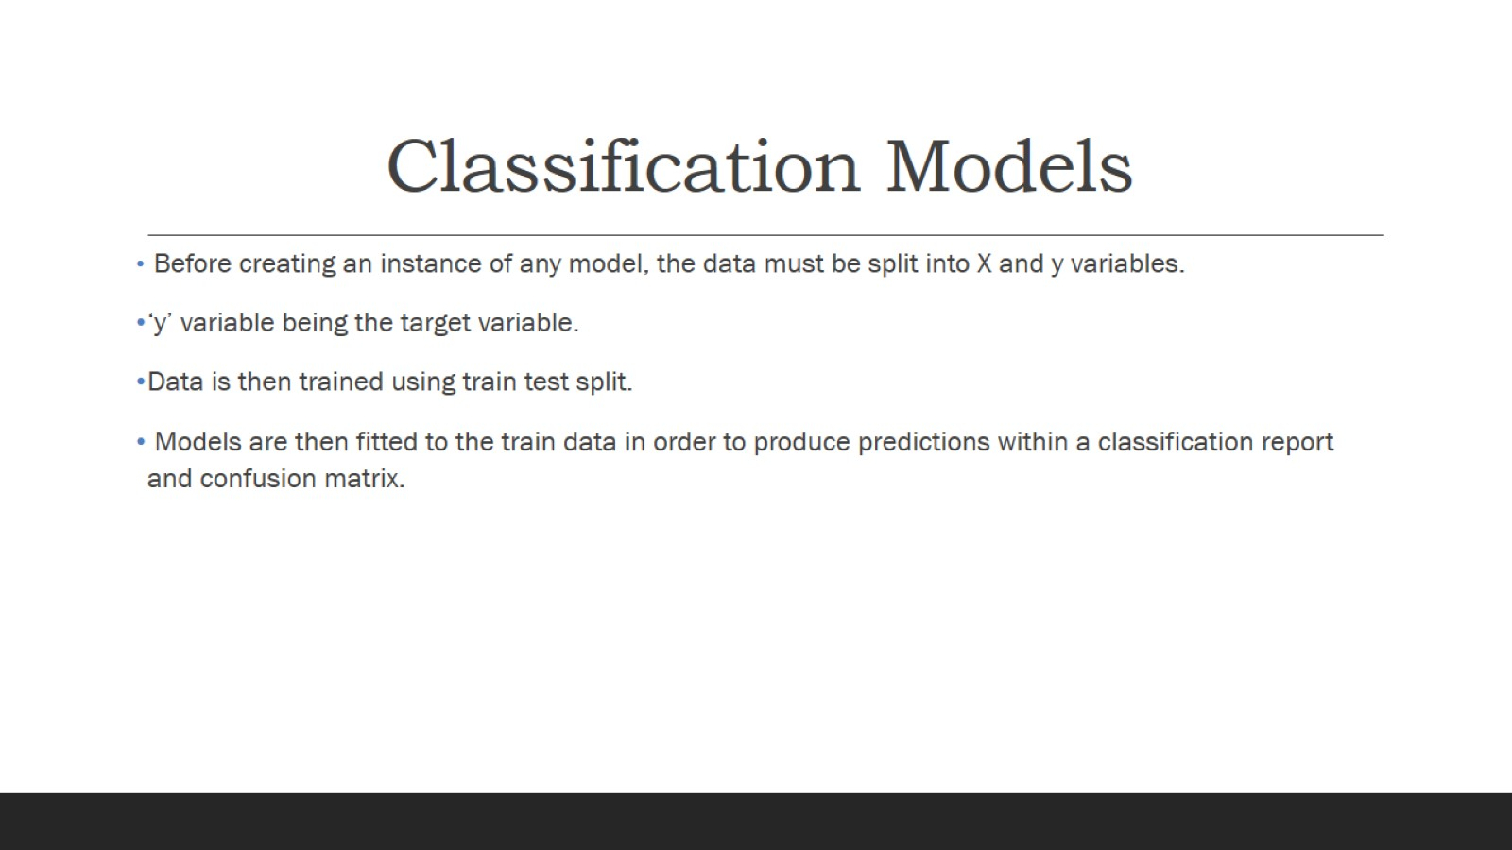
Classification Models

Slide 10
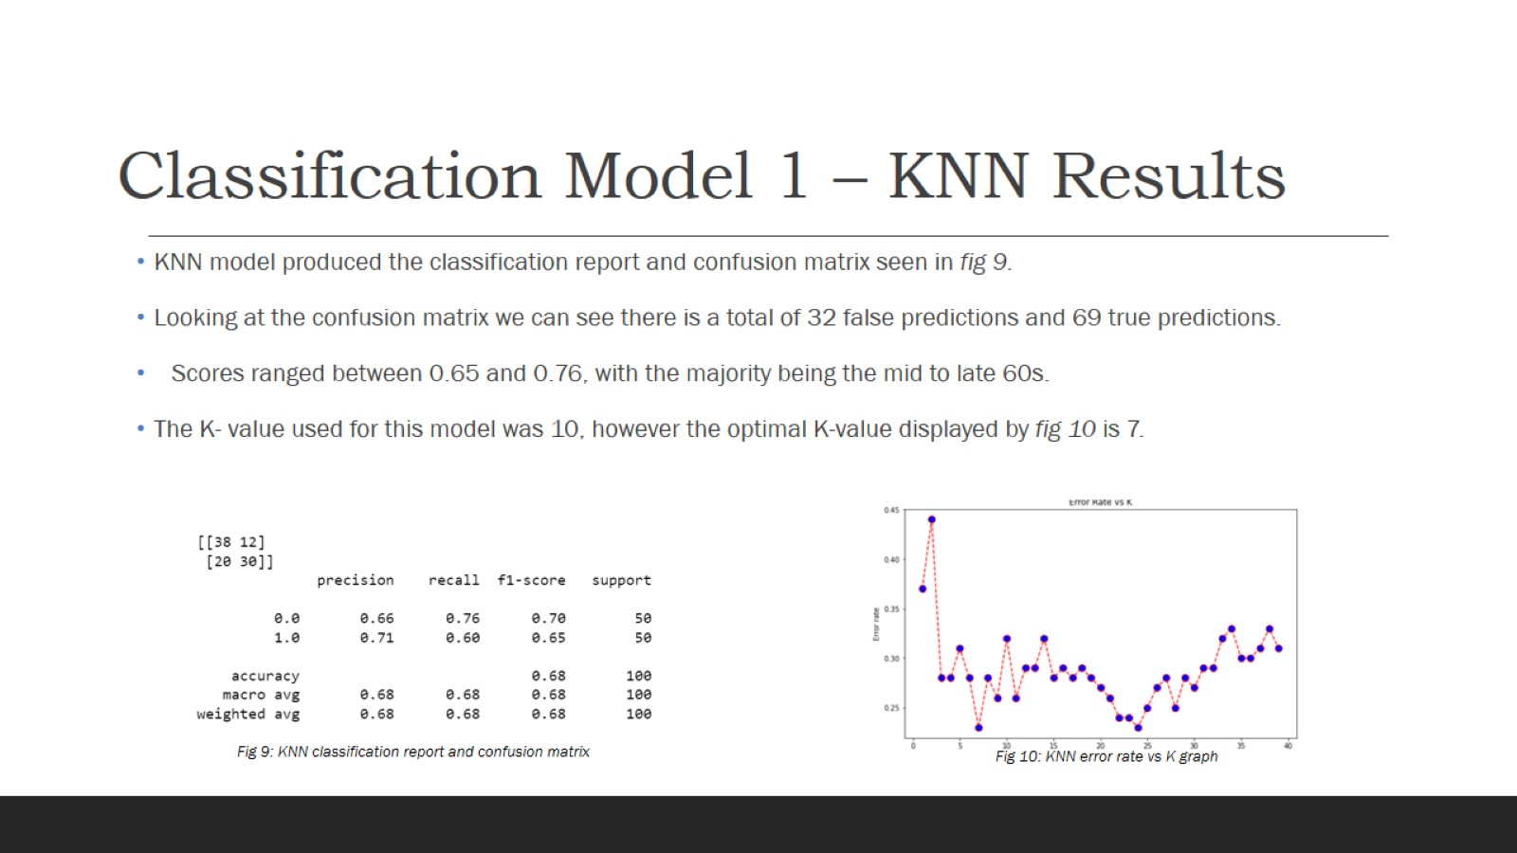
Classification Model 1 – KNN Results

Slide 11
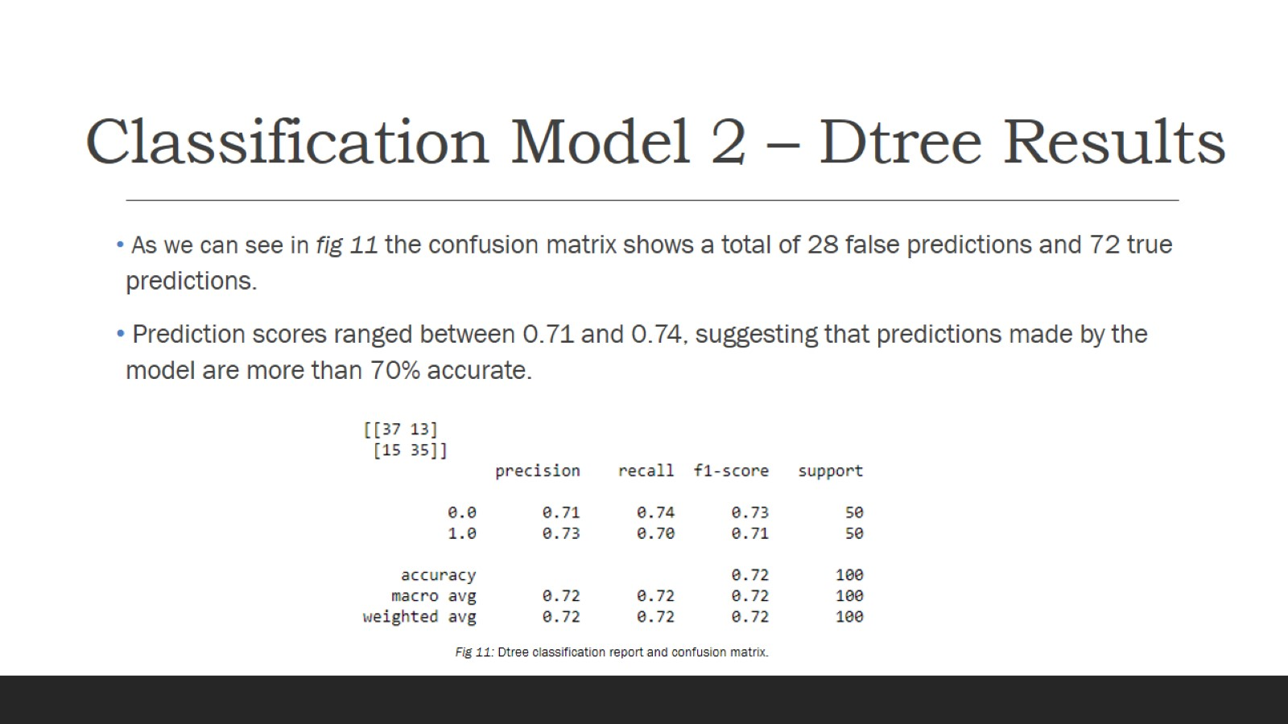
Classification Model 2 – Dtree Results

Slide 12
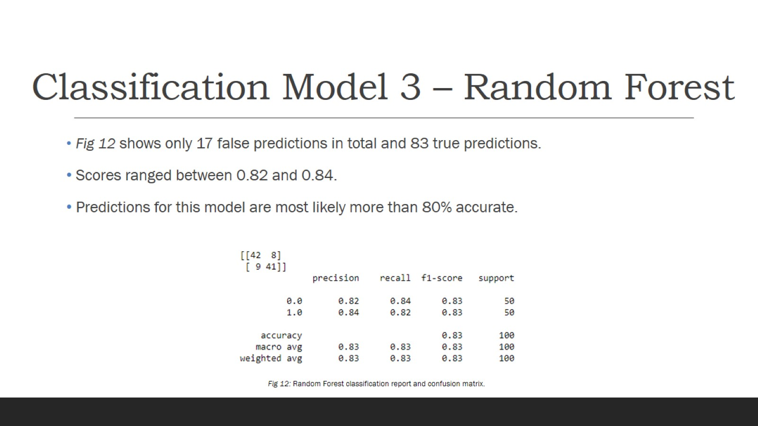
Classification Model 3 – Random Forest

Slide 13
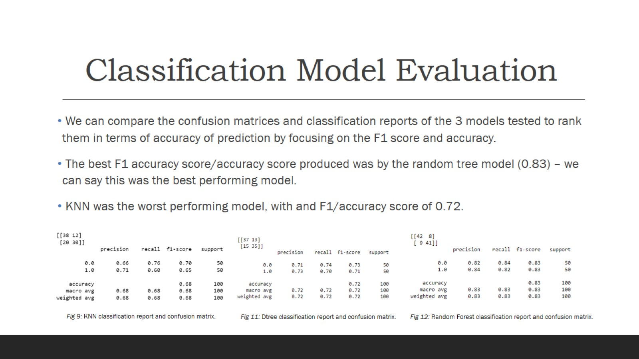
Classification Model Evaluation

Slide 14
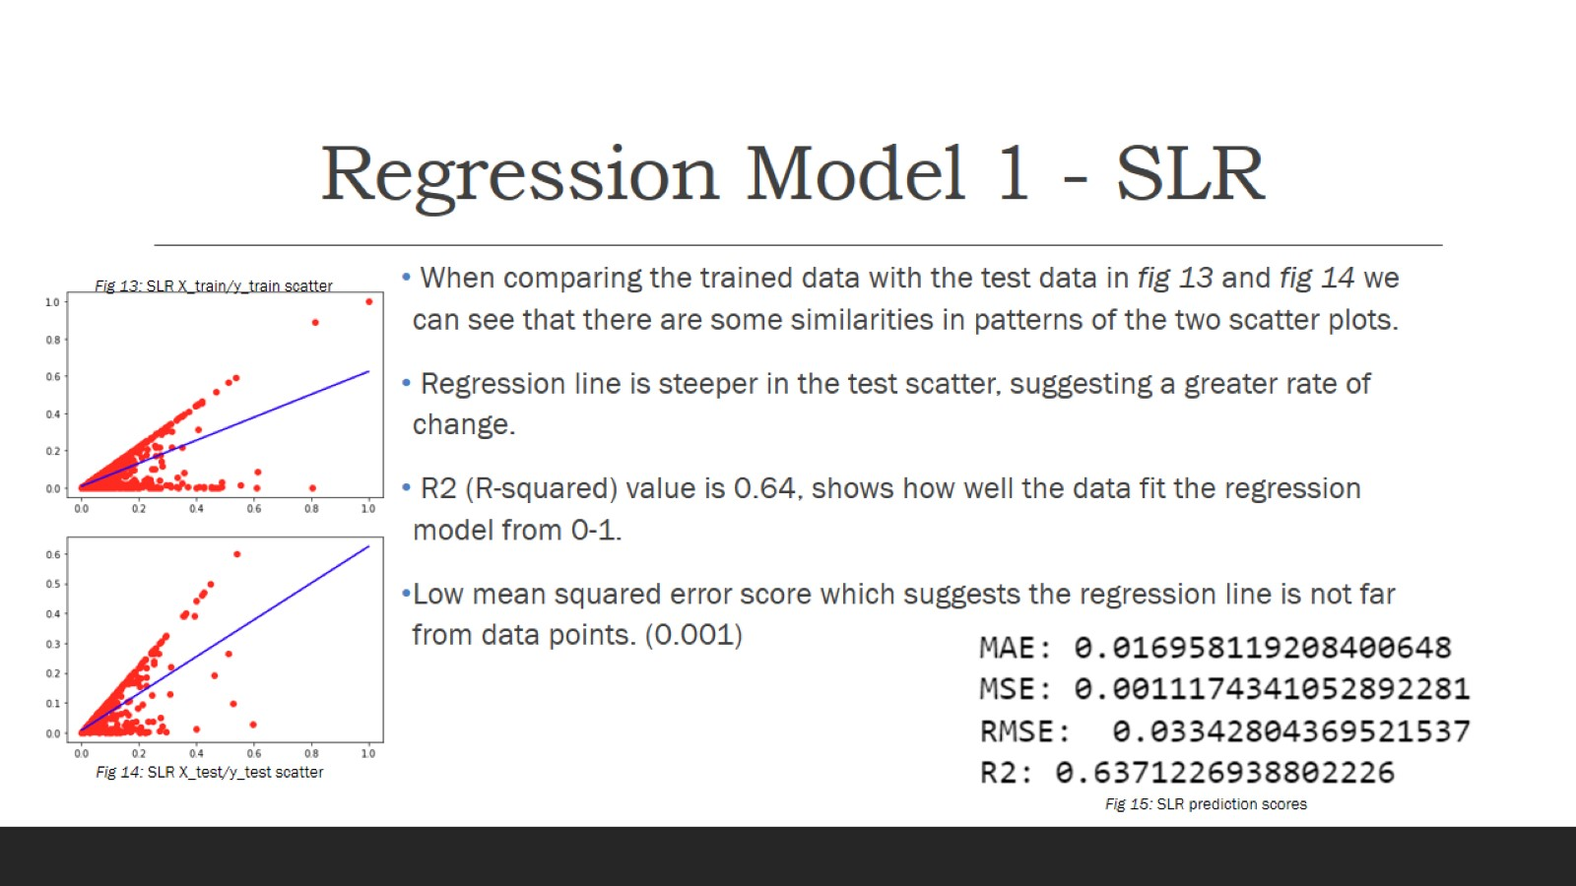
Regression Model 1 - SLR

Slide 15
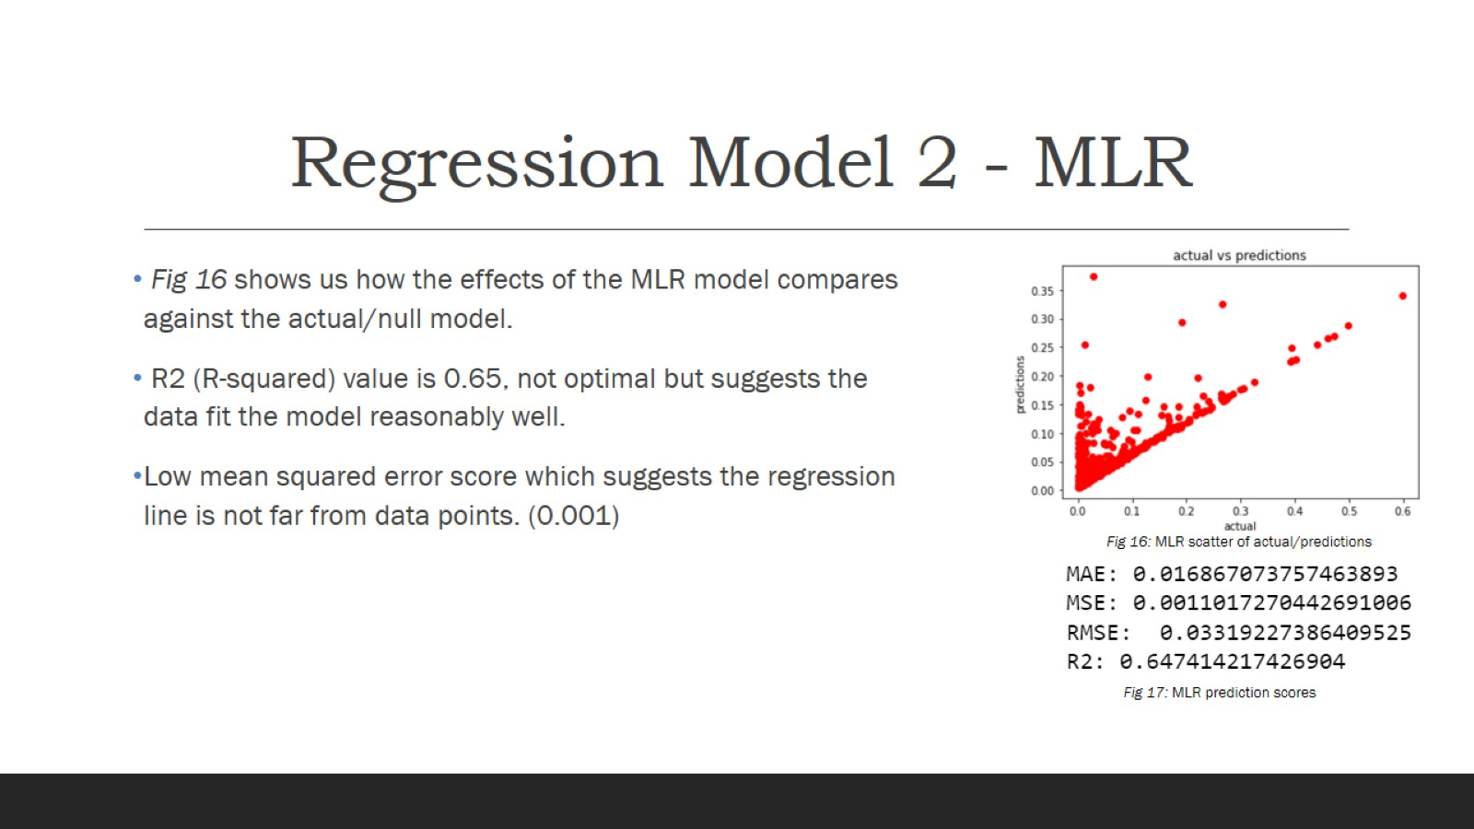
Regression Model 2 - MLR

Slide 16
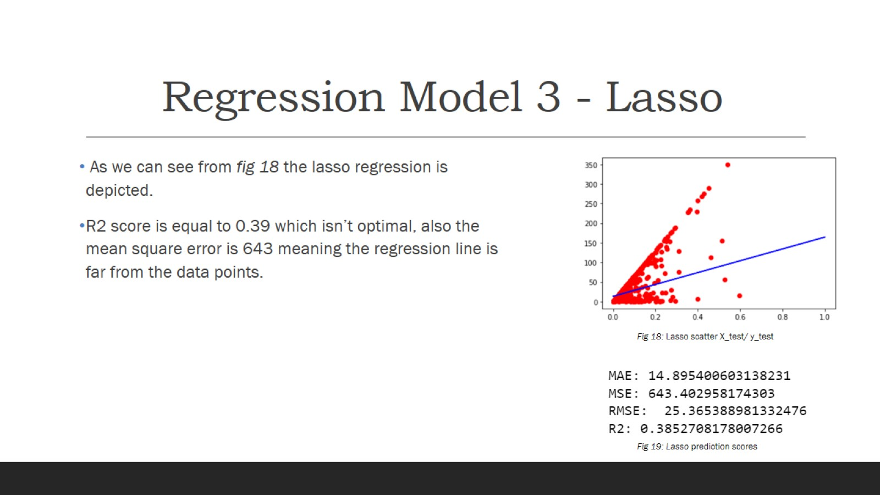
Regression Model 3 - Lasso

Slide 17
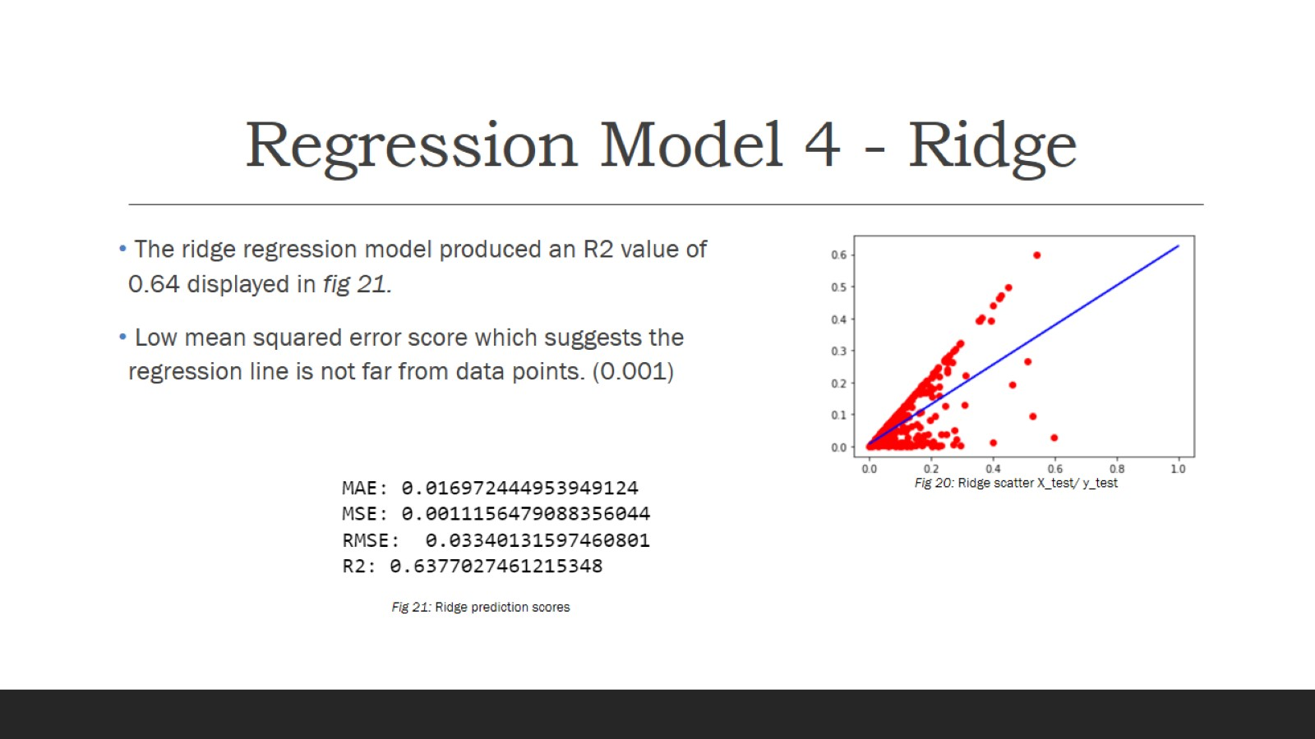
Regression Model 4 - Ridge

Slide 18
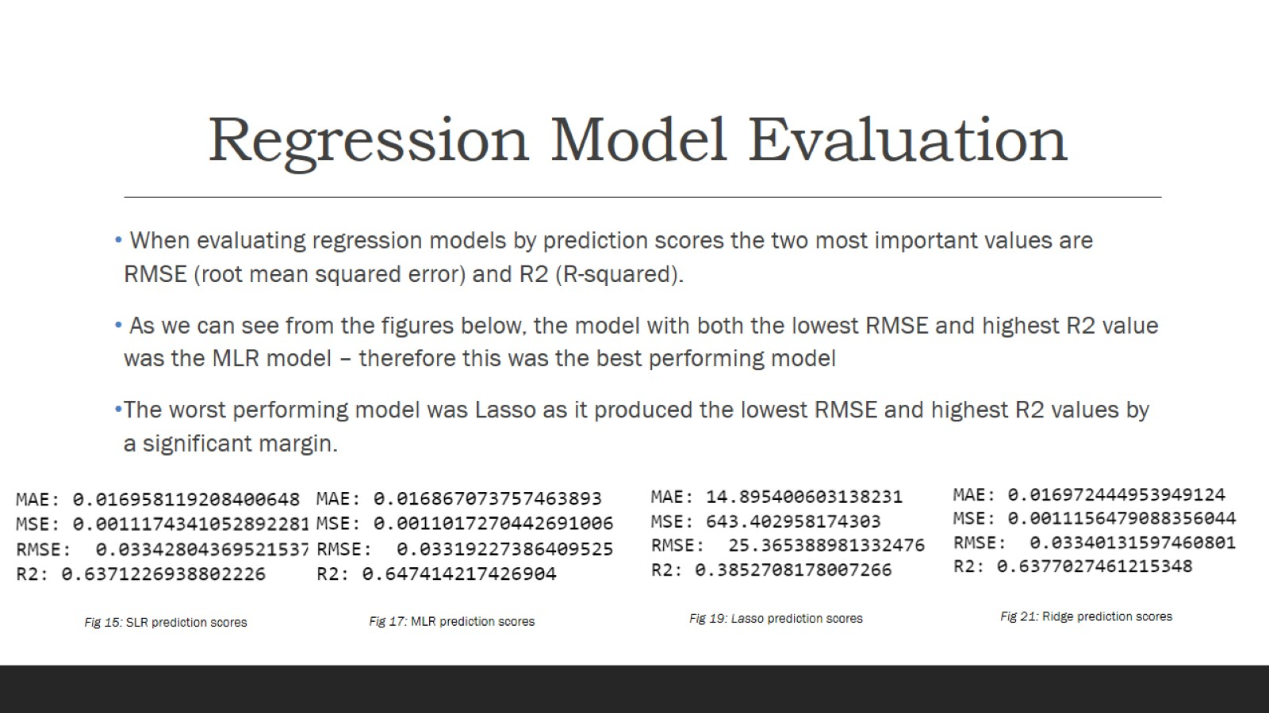
Regression Model Evaluation

Slide 19
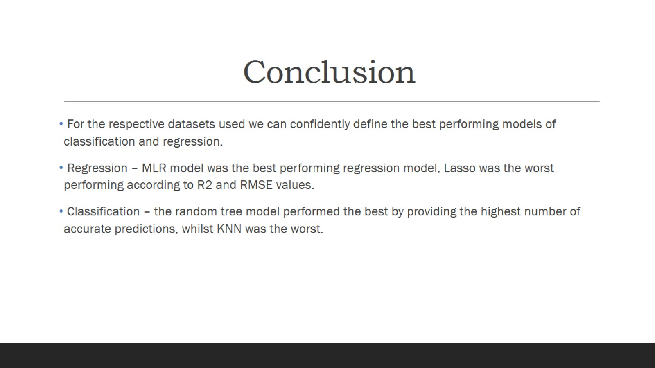
Conclusion

